Slide 1

Basics of Neural Network Programming
Vectorization
deeplearning.ai

Slide 2
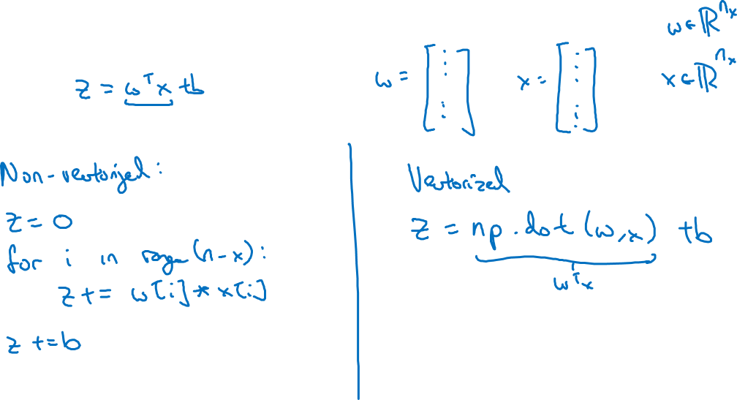
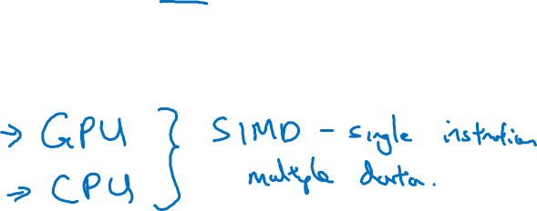
What is vectorization?

Slide 3
Basics of Neural Network Programming
More vectorization
examples
deeplearning.ai

Slide 4
Neural network programming guideline
Whenever possible, avoid explicit for-loops.

Slide 5
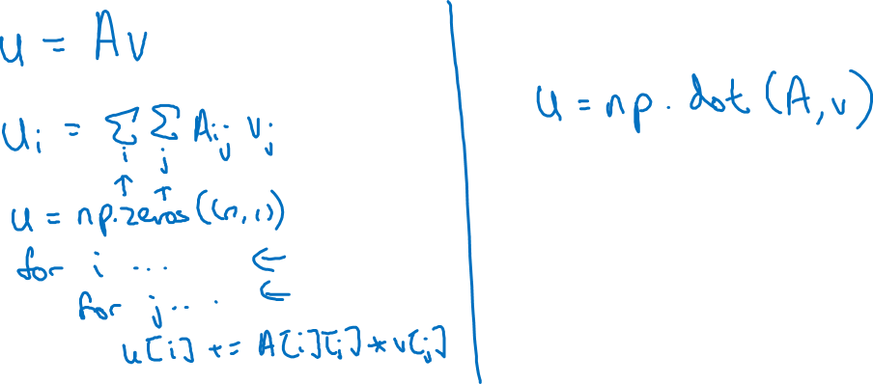
Neural network programming guideline
Whenever possible, avoid explicit for-loops.

Slide 6
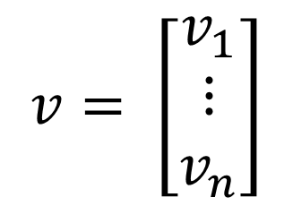
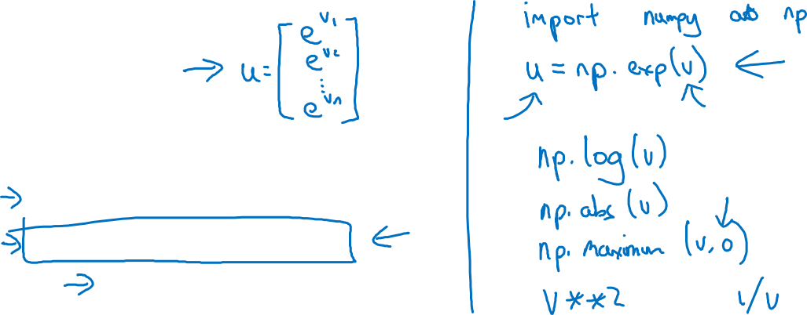
Vectors and matrix valued functions
Say you need to apply the exponential operation on every element of a matrix/vector.
$$v= \left[\begin{matrix}v_{1} \\ ⋮ \\ v_{n}\end{matrix}\right]$$
u = np.zeros((n,1))
for i in range(n):
u[i]=math.exp(v[i])

Slide 7

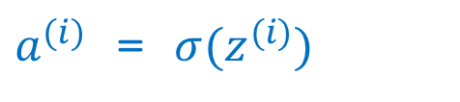
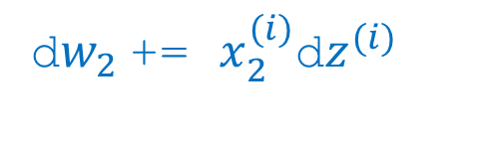
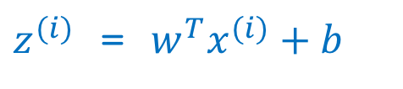
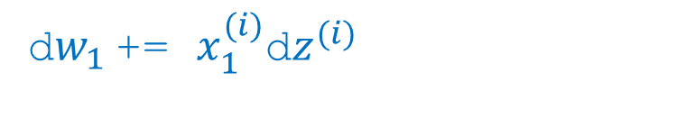
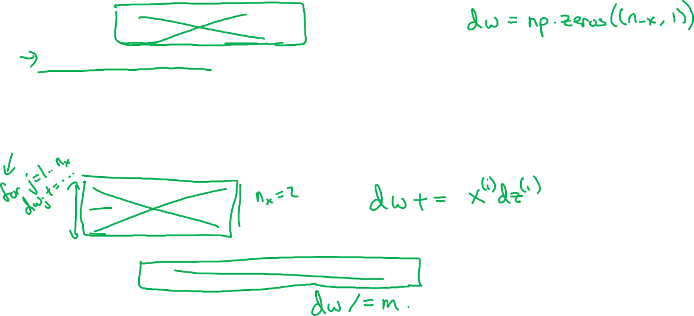
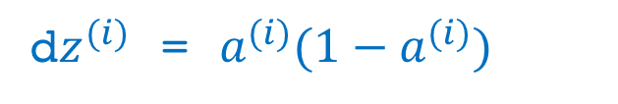
Logistic regression derivatives
J = 0, dw1 = 0, dw2 = 0, db = 0
for i = 1 to n:
$z^{(i)}$ = $w^{T}x^{(i)}+b$
$a^{(i)}$ = $σ{(z}^{(i)})$
$J$+= $−\left[y^{(i)} \log{{\hat{y}}^{\left(i\right)}+({1−y}^{\left(i\right)})\log{(1 −{\hat{y}}^{\left(i\right)})}}\right]$
d$z^{(i)}$ = $a^{(i)}{(1−a}^{(i)})$
d${w_{1}}^{ }$+= $x_{1}^{(i)}\text{d}z^{(i)}$
d${w_{2}}^{ }$+= $x_{2}^{(i)}\text{d}z^{(i)}$
db += d$z^{(i)}$
J = J/m, d$w_{1}$ = d$w_{1}$/m, d$w_{2}$ = d$w_{2}$/m, db = db/m

Slide 8
Basics of Neural Network Programming
Broadcasting in
Python
deeplearning.ai

Slide 9
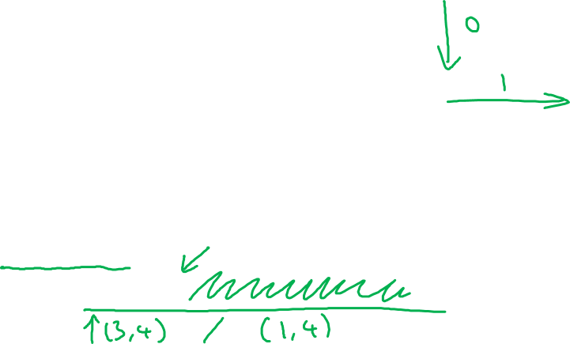
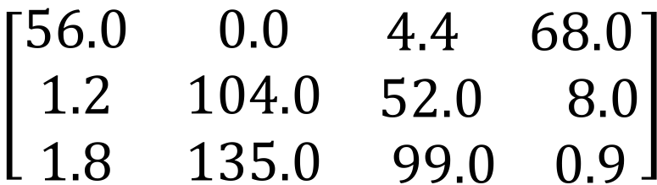
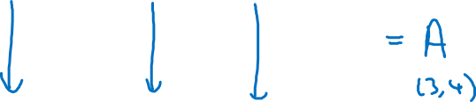
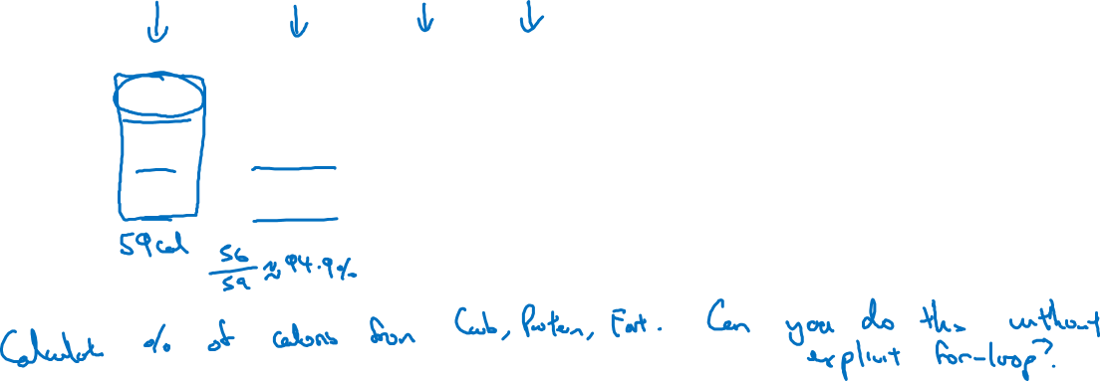
Broadcasting example
Calories from Carbs, Proteins, Fats in 100g of different foods:
Apples
Beef
Eggs
Potatoes
Carb
$$\left[\begin{matrix}56.0 & 0.0 & \begin{matrix}4.4 & 68.0\end{matrix} \\ 1.2 & 104.0 & \begin{matrix}52.0 & 8.0\end{matrix} \\ 1.8 & 135.0 & \begin{matrix}99.0 & 0.9\end{matrix}\end{matrix}\right]$$
Protein
Fat
cal = A.sum(axis = 0)
percentage = 100*A/(cal.reshape(1,4))

Slide 10
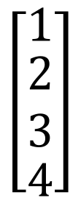
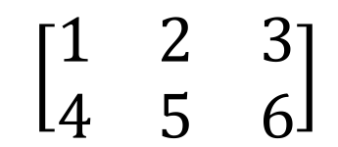
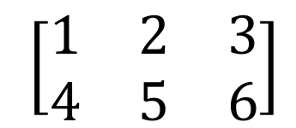
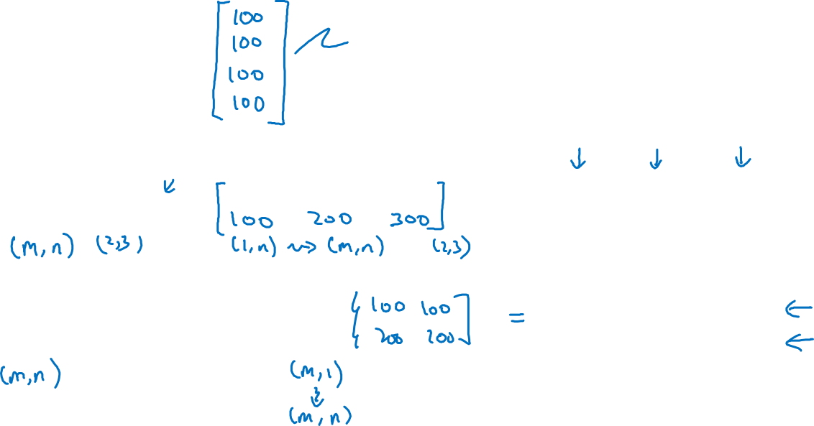
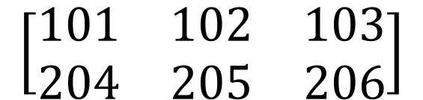

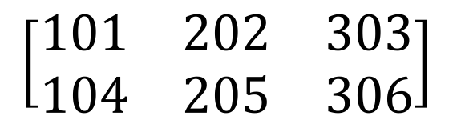

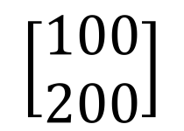

Broadcasting example
$$\left[\begin{matrix}1 \\ \begin{aligned}\begin{matrix}2 \\ 3\end{matrix} \\ 4\end{aligned}\end{matrix}\right]$$
$$\left[\begin{matrix}101 \\ \begin{aligned}\begin{matrix}102 \\ 103\end{matrix} \\ 104\end{aligned}\end{matrix}\right]$$
$$100$$
=
+
$\left[\begin{matrix}1 & 2 & 3 \\ 4 & 5 & 6\end{matrix}\right]$
$$\left[\begin{matrix}100 & 200 & 300\end{matrix}\right]$$
$$\left[\begin{matrix}101 & 202 & 303 \\ 104 & 205 & 306\end{matrix}\right]$$
+
=
$\left[\begin{matrix}1 & 2 & 3 \\ 4 & 5 & 6\end{matrix}\right]$
$$\left[\begin{matrix}100 \\ 200\end{matrix}\right]$$
$$\left[\begin{matrix}101 & 102 & 103 \\ 204 & 205 & 206\end{matrix}\right]$$
+
=

Slide 11
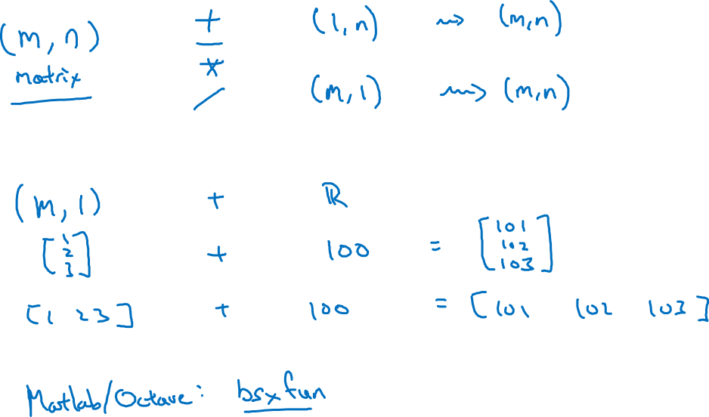
General Principle

Slide 12
Basics of Neural Network Programming
A note on python/
numpy vectors
deeplearning.ai

Slide 13
Python Demo

Slide 14
Python / numpy vectors
import numpy as np
a = np.random.randn(5)
a = np.random.randn((5,1))
a = np.random.randn((1,5))
assert(a.shape = (5,1))

